Slide 1
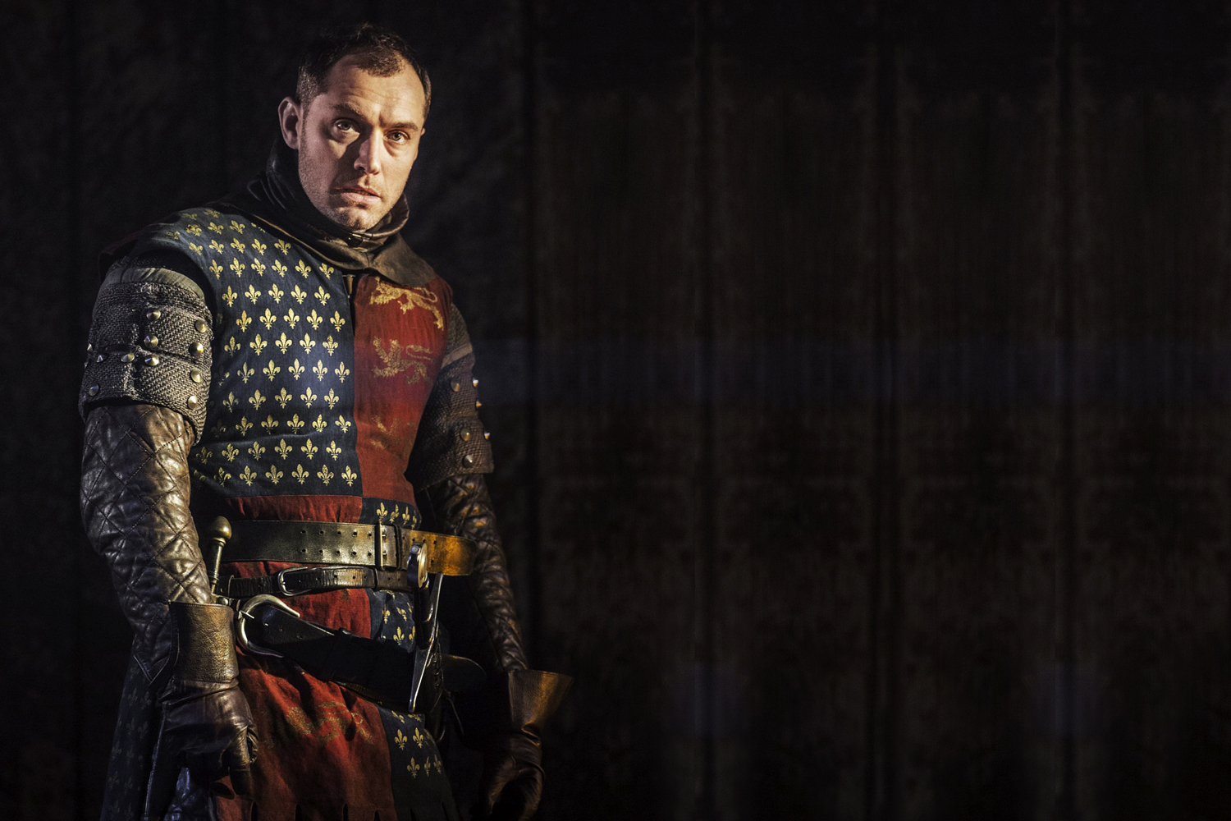
ENGLAND AFTER THE CONQUEST

Slide 2
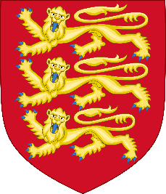
A TROUBLESOME SUCCESSION
WILLIAM I «THE CONQUEROR» (Reign: 1066 -1087)
WILLIAM II «RUFUS» (1087 - 1100)
HENRY I (1100 - 1135)
His legitimate heir died and his daughter Matilda claimed the crown,
but Stephen, Henry’s nephew, challenged her.
CIVIL WAR

Slide 3
A TROUBLESOME SUCCESSION
Neither Stephen nor Matilda were able to prevail
The CROWN lost prestige and authority
The BARONS gained MORE POWER

Slide 4
A TROUBLESOME SUCCESSION
It was agreed that Stephen would keep the crown until his death,
and that Henry of Anjou (Matilda’s son) would then succeed him
HENRY II PLANTAGENET
(r. 1153-1189)

Slide 5
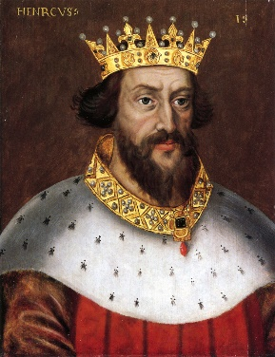
HENRY II – THE REFORMER
Henry wanted to give new strength to royal power after years of anarchy
HOW?

Slide 6
HENRY II – THE REFORMER
- REDUCTION of the POWER of BARONS
In substitution of the traditional military service they owed to the king, knights and barons could pay him a sum of money
Scutage
Safer for the barons
The king could use the money to hire mercenaries and become more militarily independent from the barons

Slide 7
HENRY II – THE REFORMER
- STRONGER, MORE EFFICIENT SYSTEM of JUSTICE
Travelling judges sent to the counties
COMMON LAW
Why «common»?
Based on:
Custom
Comparison
Previous cases and decisions
Because it was used everywhere
STILL USED TODAY!

Slide 8
HENRY II – THE REFORMER
- REDUCTION of the POWER of the CHURCH
Members of the clergy who committed crimes were to be judged by the King’s Court first, then by the ecclesial court
Constitution of Clarendon (1164)
This measure was aimed at reducing the Church’s privileges, and to extend royal control over it

Slide 9
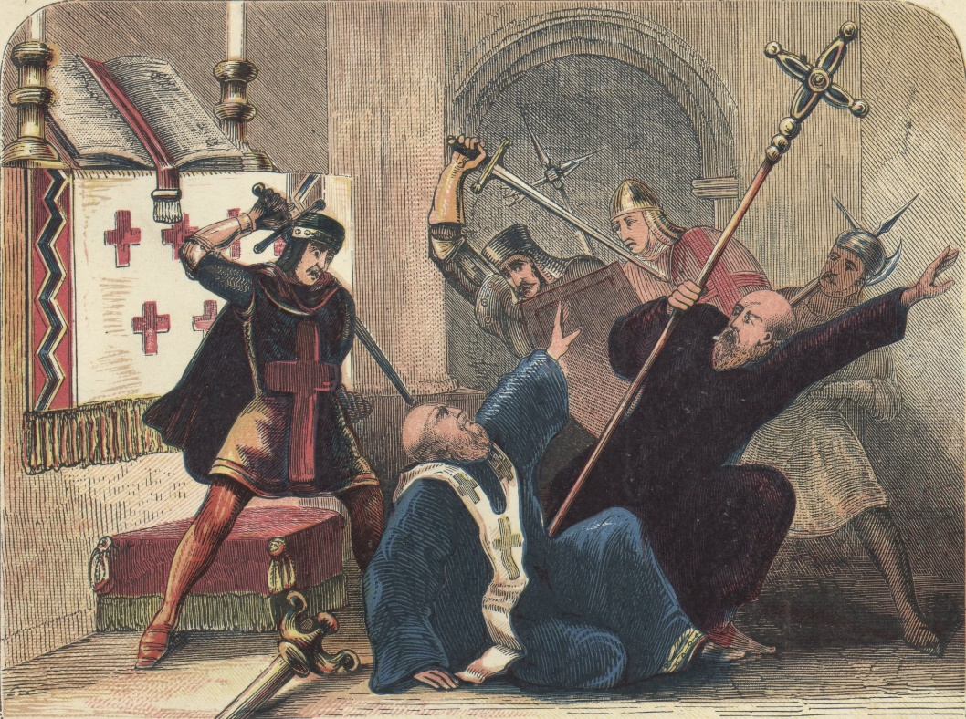
HENRY II – THE REFORMER
The Church opposed the King’s strategy
THOMAS BECKET
(1118-1170)
Formerly the King’s Chancellor and friend
then Archbishop of Canterbury
Abandoned the King’s cause and sided with the Pope
Killed in the Canterbury cathedral by four of the King’s knights
Miracles were attributed to him after his death
PILGRIMAGES

Slide 10
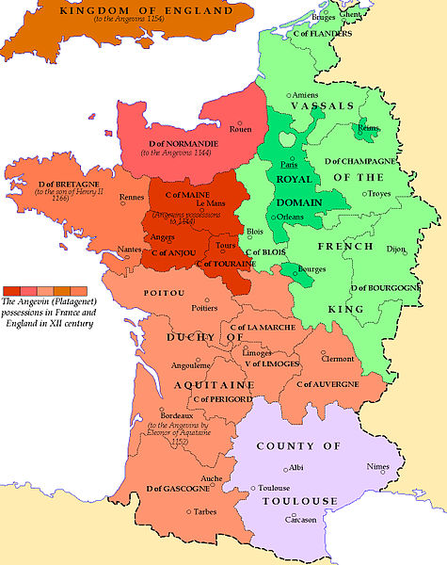
HENRY II and FRANCE
Thanks to his Angevin origins, Henry II was also lord of vast territories in France
England and its history are inextricably tied with France
Angevin possessions in France – XII century

Slide 11
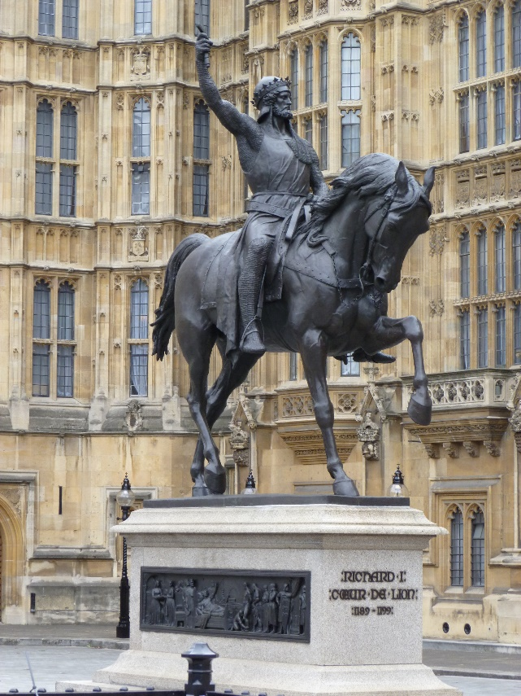
KING RICHARD and JOHN LACKLAND
Henry II died in 1189
RICHARD I «LIONHEART»
Spent most of his reign abroad, fighting wars
His brother JOHN took his place
When Richard died in 1199, the barons chose John as King

Slide 12
KING RICHARD and JOHN LACKLAND
John soon became extremely unpopular
Despite expensive military campaigns, he lost most French territories
Hence his nickname «Lackland»
Excessive taxation
The BARONS REBELLED against him!

Slide 13
The MAGNA CARTA
John was forced to sign a document that shaped the history of England
MAGNA CARTA LIBERTATUM
1215
It introduced limitations to royal power such as:
HABEAS CORPUS [Prohibition of arbitrary imprisonment]
Baronial oversight on taxation

Slide 14
KEY ISSUES
KING vs BARONS
KING vs CHURCH
ENGLAND and FRANCE

